Slide 1
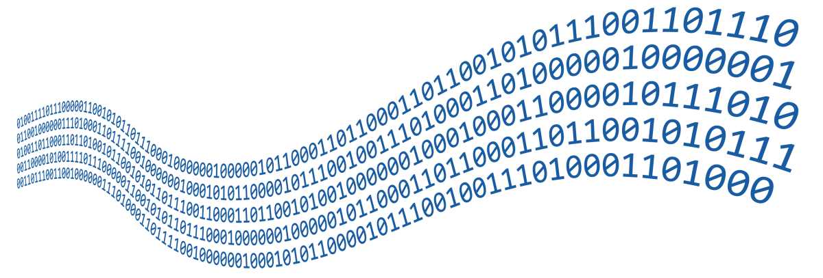
Streams, Files and Directories
File Types, Using Streams and Manipulating Files
SoftUni Team
Technical Trainers
Software University
http://softuni.bg

Slide 2

Table of Contents
What are Streams?
2. Readers and Writers
3. File Streams
4. File Class
5. Directory Class

Slide 3
Have a Question?
sli.do
#fund-csharp

Slide 4

What Is a Stream?
Basic Concepts

Slide 5


What is a Stream?
Streams are used to transfer data
We open a stream to:
Read data
Write data
1100 1001 1001
Stream
Notes:
Icons by Chanut is Industries / Pixel perfect at http://www.flaticon.com/

Slide 6
Stream Basics
Streams are means for transferring (reading and writing) data
Streams are ordered sequences of bytes
Provide sequential access to its elements
Different types of streams are available to access different data sources:
File access, network access, memory streams and others
Streams are opened before using them and closed after that

Slide 7
Stream – Example
Length = 9
Position is the current position in the stream
Buffer keeps n bytes of the stream from the current position
F i l e s a n d
46 | 69 | 6c | 65 | 73 | 20 | 61 | 6e | 64
Position
Buffer
46 | 69
6c | 65
73 | 20
61 | 6e
64

Slide 8
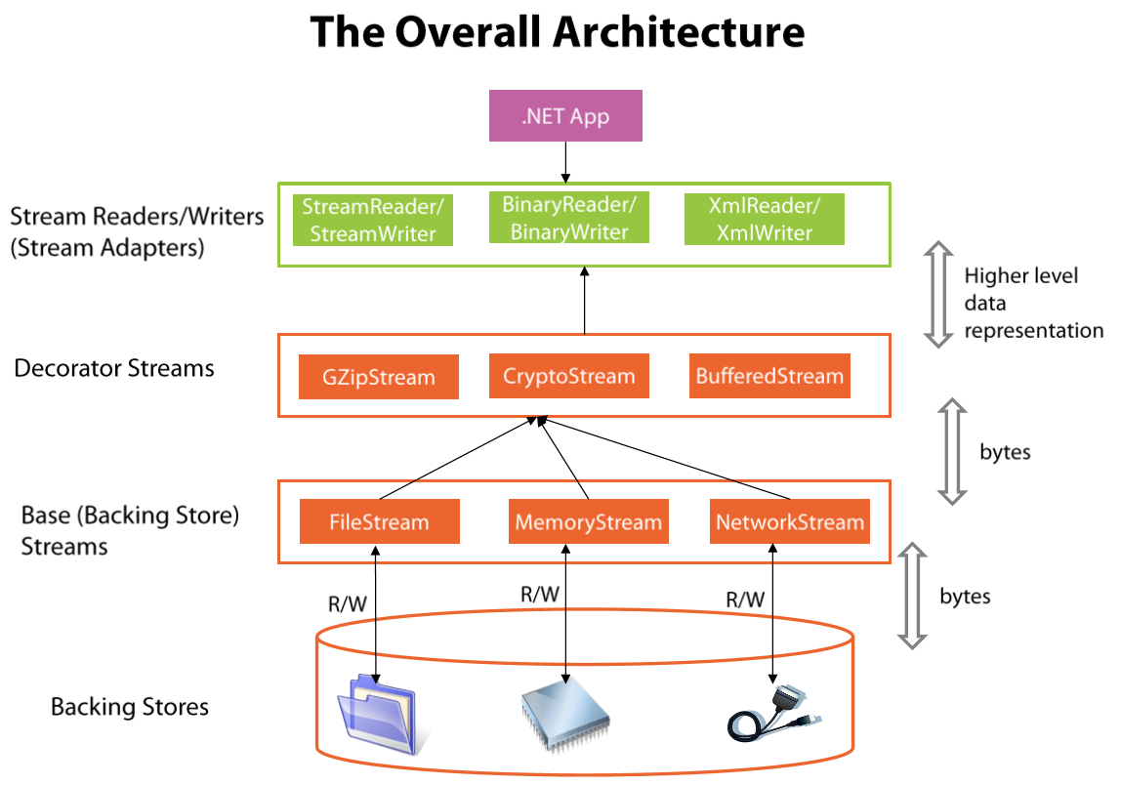
Stream Types in .NET

Slide 9

Readers and Writers
Text and Binary Readers/Writers

Slide 10
Readers and Writers
Readers and writers are classes, which facilitate the work with streams
Two types of streams
Text readers/writers – StreamReader / StreamWriter
Provide methods ReadLine(), WriteLine() (similar to working with the system class Console)
Binary readers/writers – BinaryReader / BinaryWriter
Provide methods for working with primitive types
ReadInt32(), ReadBoolean(), WriteChar(), etc.

Slide 11
Using statement
Streams, readers, files, etc. use certain resources
Using statement closes them and releases their resources
var reader = new StreamReader(fileName);
using (reader)
{
// Use the reader here
}

Slide 12
Problem: Odd Lines
Read the content from your Input.txt file
Print the odd lines on the console
Counting starts from 0
Two households, both alike in dignity, In fair Verona, where we lay our scene, From ancient grudge break to new mutiny, Where civil blood makes civil hands unclean.
In fair Verona, where we lay our scene,
Where civil blood makes civil hands unclean.

Slide 13
Solution: Odd Lines
var reader = new StreamReader("Input.txt");
using (reader){
int counter = 0;
string line = reader.ReadLine();
using (var writer = new StreamWriter("Output.txt")){
while (line != null){
if (counter % 2 == 1){
writer.WriteLine(line);}
counter++;
line = reader.ReadLine();}}}

Slide 14
Problem: Line Numbers
Read your Input.txt file
Insert a number in front of each line of the file
Save it in Output.txt
Two households, both alike in dignity, In fair Verona, where we lay our scene, From ancient grudge break to new mutiny, Where civil blood makes civil hands unclean.
1. Two households, both alike in dignity, 2. In fair Verona, where we lay our scene, 3. From ancient grudge break to new mutiny, 4. Where civil blood makes civil hands unclean.

Slide 15
Solution: Line Numbers
using (var reader = new StreamReader("Input.txt"))
{
string line = reader.ReadLine();
int counter = 1;
using (var writer = new StreamWriter("Output.txt"))
{
while (line != null)
{
writer.WriteLine($"{counter}. {line}");
line = reader.ReadLine();
counter++;
}
}
}

Slide 16

Base Streams

Slide 17
The System.IO.Stream Class
The base class for all streams is System.IO.Stream
There are defined methods for the main operations with streams in it
Some streams do not support read, write or positioning operations
Properties CanRead, CanWrite and CanSeek are provided
Streams which support positioning have the properties Position and Length

Slide 18
Methods of System.IO.Stream Class
int Read(byte[] buffer, int offset, int count)
Read as many as count bytes from input stream, starting from the given offset position
Returns the number of read bytes or 0 if end of stream is reached
Can freeze for undefined time while reading at least 1 byte
Can read less than the claimed number of bytes
F i l e s a n d
46 | 69 | 6c | 65 | 73 | 20 | 61 | 6e | 64

Slide 19
Methods of System.IO.Stream Class (2)
Write(byte[] buffer, int offset, int count)
Writes a sequence of count bytes to an output stream, starting from the given offset position
Can freeze for undefined time, until it sends all bytes to their destination
Flush()
Sends the internal buffers data to its destination (data storage, I/O device, etc.)

Slide 20
Methods of System.IO.Stream Class (3)
Close()
Calls Flush()
Closes the connection to the device (mechanism)
Releases the used resources
Seek(offset, SeekOrigin)
Moves the position (if supported) with given offset towards the beginning, the end or the current position

Slide 21

File Stream

Slide 22
The FileStream Class
Inherits the Stream class and supports all its methods and properties
Supports reading, writing, positioning operations, etc.
The constructor contains parameters for:
File name
File open mode
File access mode
Concurrent users access mode

Slide 23
The FileStream Class (2)
FileMode – opening file mode
Open, Append, Create, CreateNew, OpenOrCreate, Truncate
FileAccess – operations mode for the file
Read, Write, ReadWrite
FileShare – access rules for other users while file is opened
None, Read, Write, ReadWrite
var fs = new FileStream(string fileName, FileMode,
[FileAccess], [FileShare]);
Optional parameters

Slide 24
Writing Text to File – Example
string text = "Кирилица";
var fileStream = new FileStream("../../log.txt",
FileMode.Create);
try {
byte[] bytes = Encoding.UTF8.GetBytes(text);
fileStream.Write(bytes, 0, bytes.Length);
}
finally
{ fileStream.Close(); }
try-finally guarantees the stream will always close
Encoding.UTF8.GetBytes() returns the underlying bytes of the character

Slide 25

Problem: Slice File
Slice the file sliceMe.txt in 4 equal parts
Name them
Part-1.txt
Part-2.txt
Part-3.txt
Part-4.txt

Slide 26
Solution: Slice File
string destinationDirectory = ""; //Add saving path
string sourceFile = ""; //Add file path
int parts = 4;
List<string> files = new List<string> { "Part-1.txt", "Part-2.txt ", "Part-3.txt ", "Part-4.txt" };
using (var streamReadFile = new FileStream(sourceFile, FileMode.Open)){
long pieceSize = (long)Math.Ceiling((double)streamReadFile.Length / parts);
for (int i = 0; i < parts; i++){
long currentPieceSize = 0;
//Continue to next slide
}}

Slide 27
Solution: Slice File(2)
using (var streamCreateFile = new FileStream(files[i], FileMode.Create)){
byte[] buffer = new byte[4096];
while ((streamReadFile.Read(buffer, 0, buffer.Length)) == buffer.Length){
currentPieceSize += buffer.Length; streamCreateFile.Write(buffer, 0, buffer.Length);
if (currentPieceSize >= pieceSize){break;}
}
}

Slide 28


File Class in .NET
.NET API for Easily Working with Files

Slide 29
Reading Text Files
File.ReadAllText() → string – reads a text file at once
File.ReadAllLines() → string[] – reads a text file's lines
using System.IO;
…
string text = File.ReadAllText("file.txt");
using System.IO;
…
string[] lines = File.ReadAllLines("file.txt");

Slide 30
Writing Text Files
Writing a string to a text file:
Writing a sequence of strings to a text file, at separate lines:
Appending additional text to an existing file:
File.WriteAllText("output.txt", "Files are fun :)");
string[] names = { "peter", "irina", "george", "maria" };
File.WriteAllLines("output.txt", names);
File.AppendAllText("output.txt", "\nMore text\n");

Slide 31

Directory Class in .NET
.NET API for Working with Directories

Slide 32
Basic Directory Operations
Creating a directory (with all its subdirectories at the specified path), unless they already exists:
Deleting a directory (with its contents):
Moving a file or a directory to a new location:
Directory.CreateDirectory("TestFolder");
Directory.Delete("TestFolder", true);
Directory.Move("Test", "New Folder");

Slide 33
Listing Directory Contents
GetFiles() – returns the names of the files (including their paths) in the specified directory
GetDirectories() – returns the names of the subdirectories (including their paths) in the specified directory
string[] filesInDir =
Directory.GetFiles("TestFolder");
string[] subDirs =
Directory.GetDirectories("TestFolder");

Slide 34
Problem: Calculate Folder Size
You are given a folder named TestFolder
Calculate the size of all files in the folder (without subfolders)
Print the result in a file "output.txt" in Megabytes
output.txt
5.16173839569092

Slide 35
Solution: Calculate Folder Size
string[] files = Directory.GetFiles("TestFolder");
double sum = 0;
foreach (string file in files)
{
FileInfo fileInfo = new FileInfo(file);
sum += fileInfo.Length;
}
sum = sum / 1024 / 1024;
File.WriteAllText("оutput.txt", sum.ToString());

Slide 36

Live Exercises

Slide 37

Summary
Streams are ordered sequences of bytes
Serve as I/O mechanisms
Can be read or written to (or both)
Always close streams by using try-finally or using(…)
Use the File class to work with files
Use the Directory class to work with directories
…
…
…

Slide 38
https://softuni.bg/trainings/courses

Slide 39













SoftUni Diamond Partners

Slide 40




SoftUni Organizational Partners

Slide 41




Trainings @ Software University (SoftUni)
Software University – High-Quality Education and Employment Opportunities
softuni.bg
Software University Foundation
http://softuni.foundation/
Software University @ Facebook
facebook.com/SoftwareUniversity
Software University Forums
forum.softuni.bg

Slide 42

License
This course (slides, examples, demos, videos, homework, etc.) is licensed under the "Creative Commons Attribution-NonCommercial-ShareAlike 4.0 International" license

